Slide 1
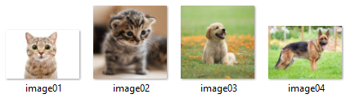
Portfolio 01
How to predict these by using your pc
Or how to train your computer???

Slide 2
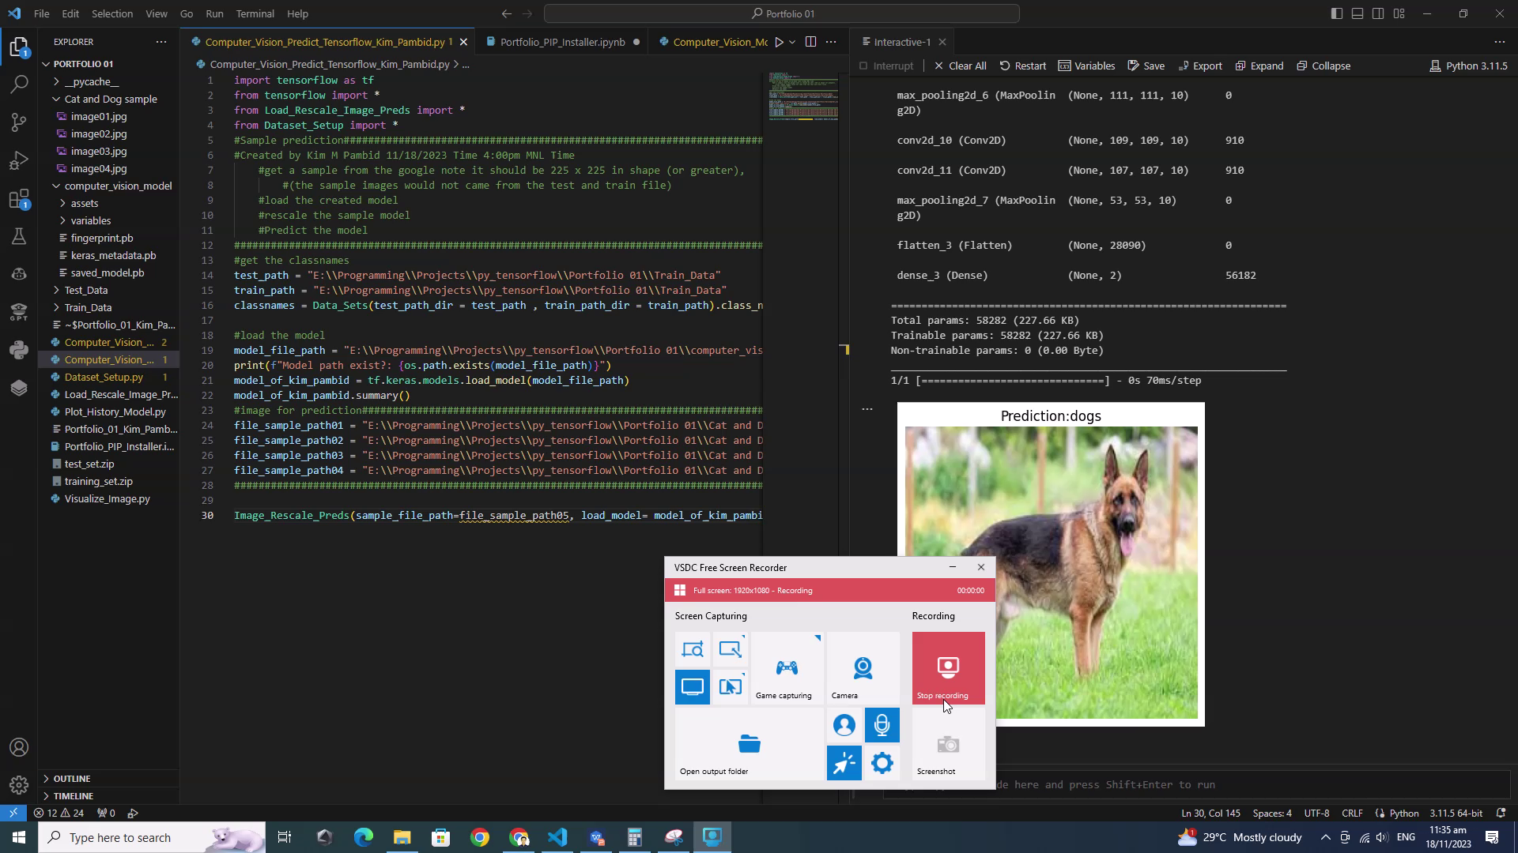
The Result Prediction
Click the image it is a video :)

Slide 3
How i do it???

Slide 4
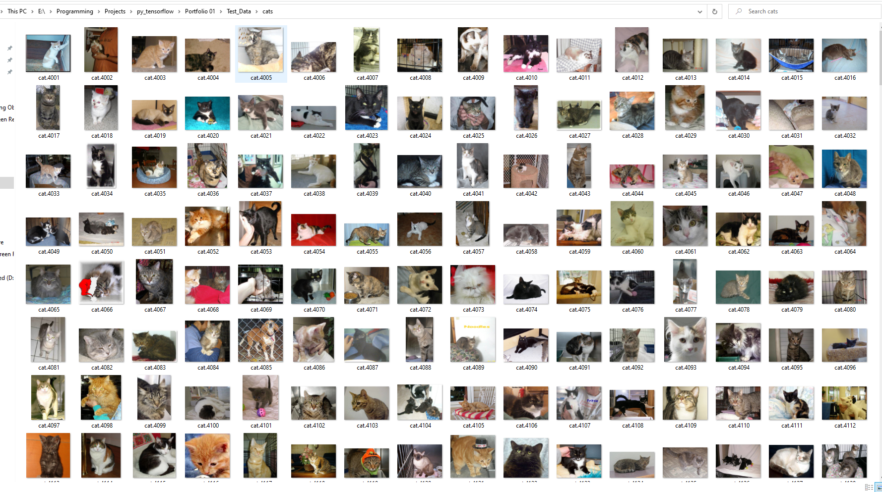
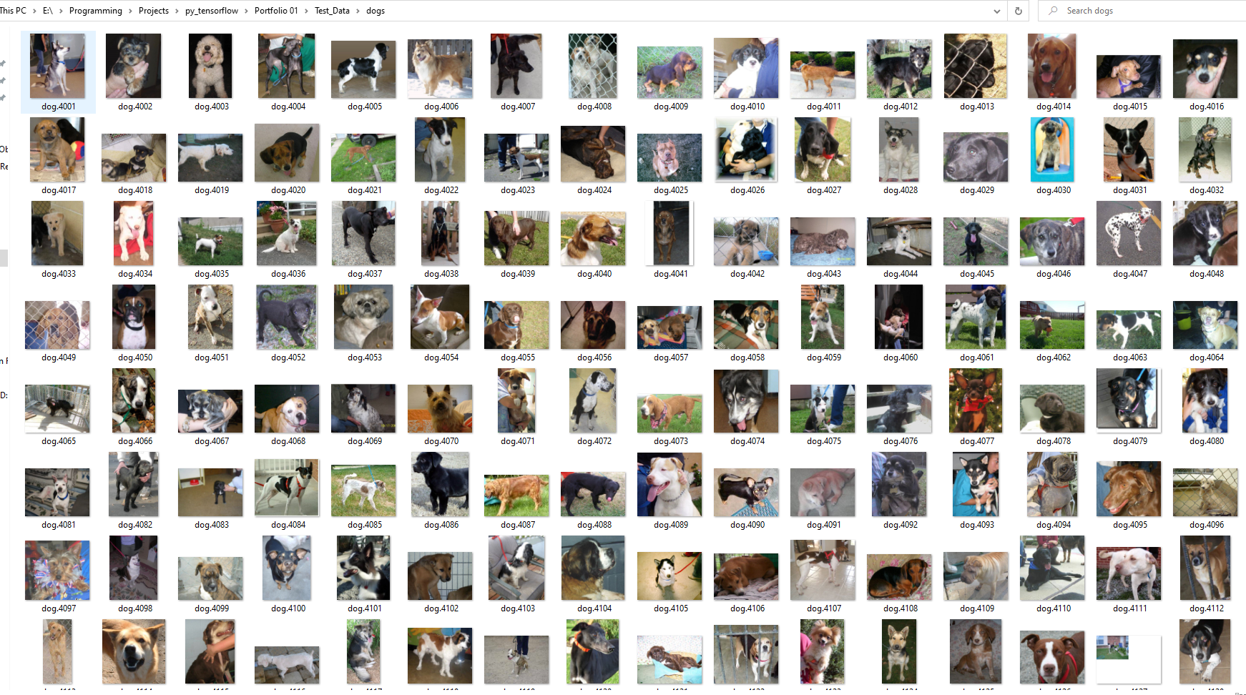
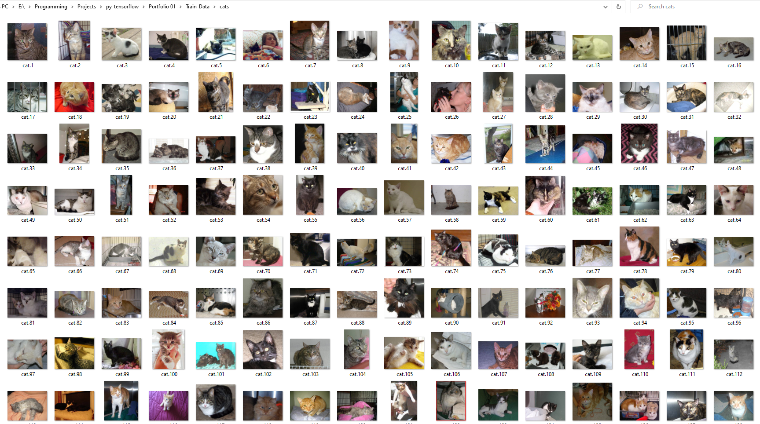
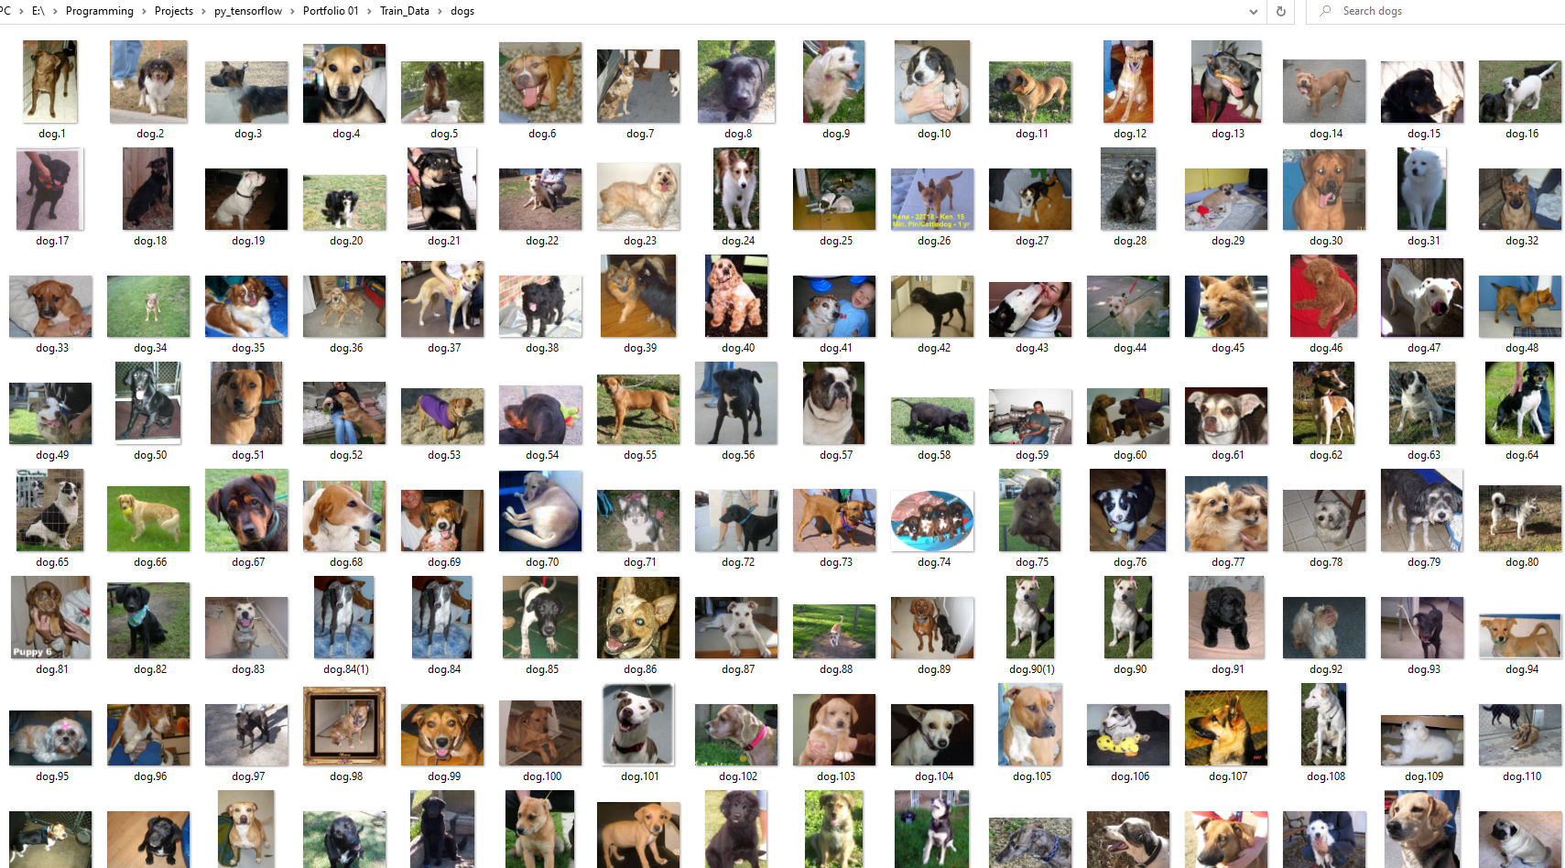
Download many many many image
May be a least a thousands!!! :p
Note there shouldn’t be identical image on Train,Test and Sample folders!!!
(for short no leakage of data!!!)
The Test Folder (for comparison)
Note it should be 30% of all your images
The Train Folder (for training)
Note it should be 70% of all your images
Remember: training data should be hell as much. To help the computer recognize the patterns of the data.

Slide 5
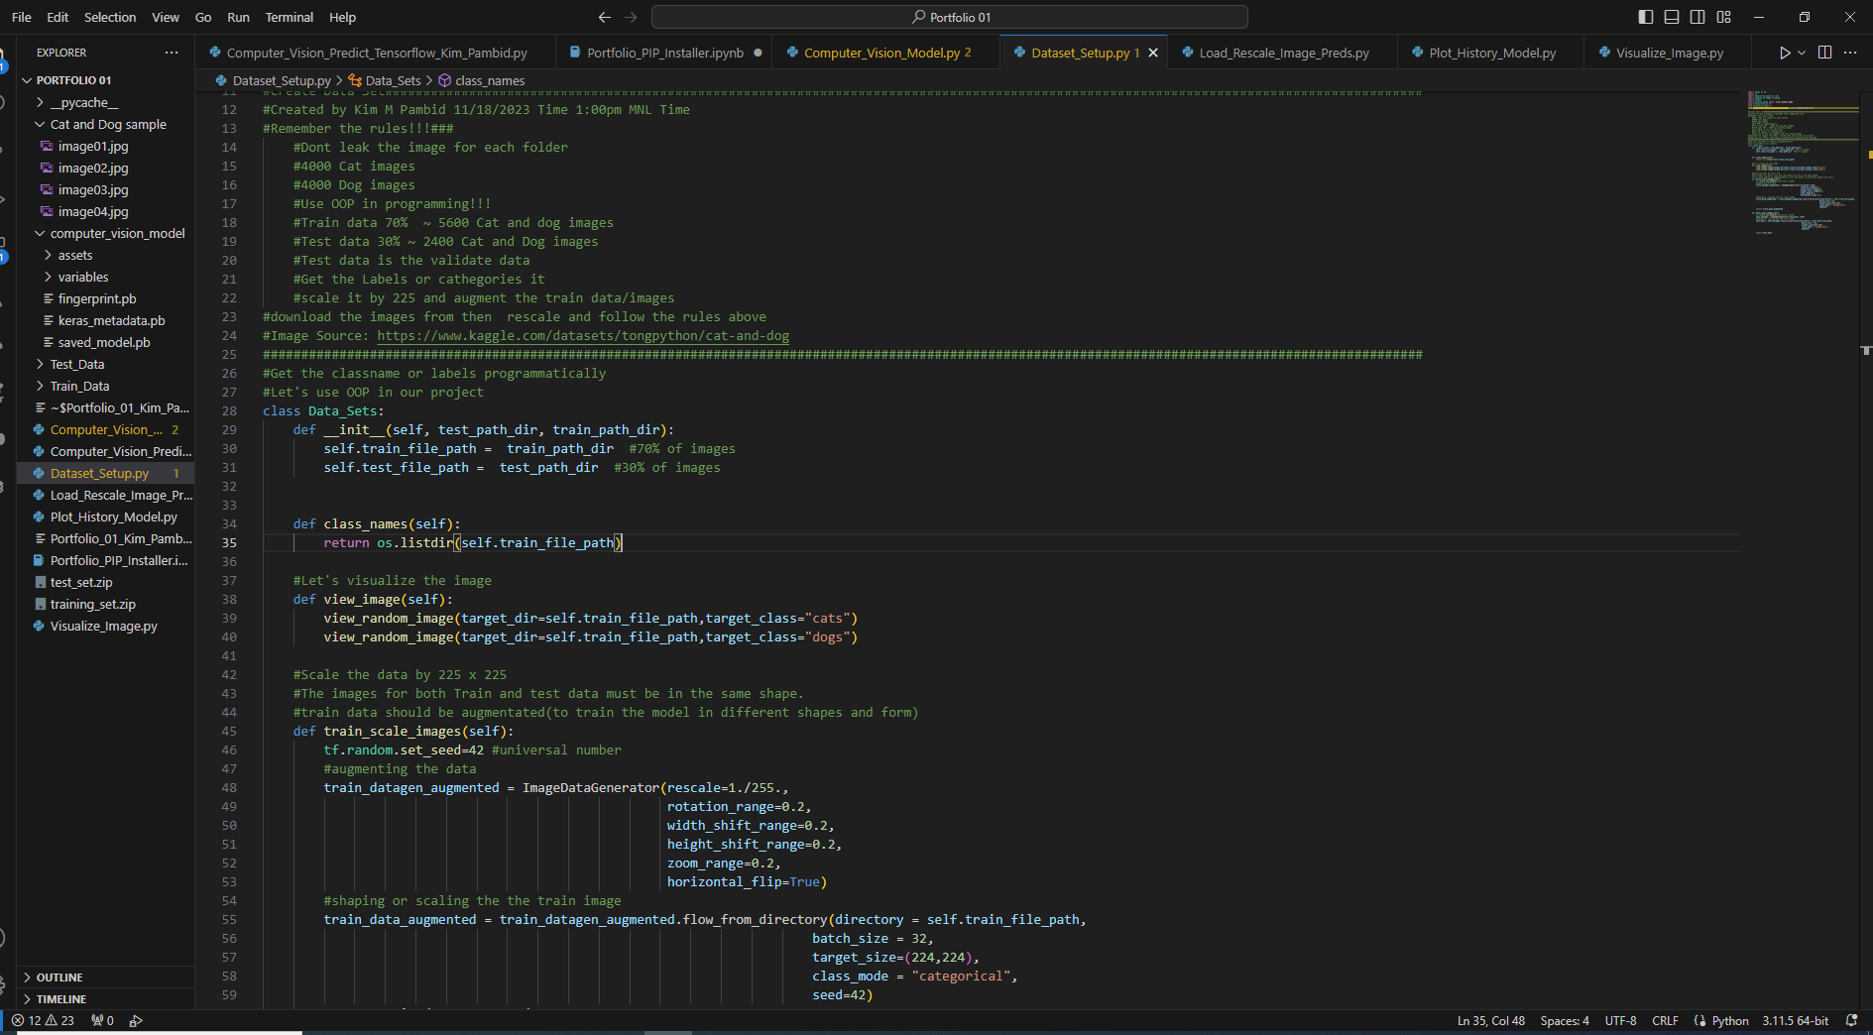
Rescale the images for Train and Test data
See the box below!!

Slide 6
Creating the model
The difficult stuff!!!

Slide 7
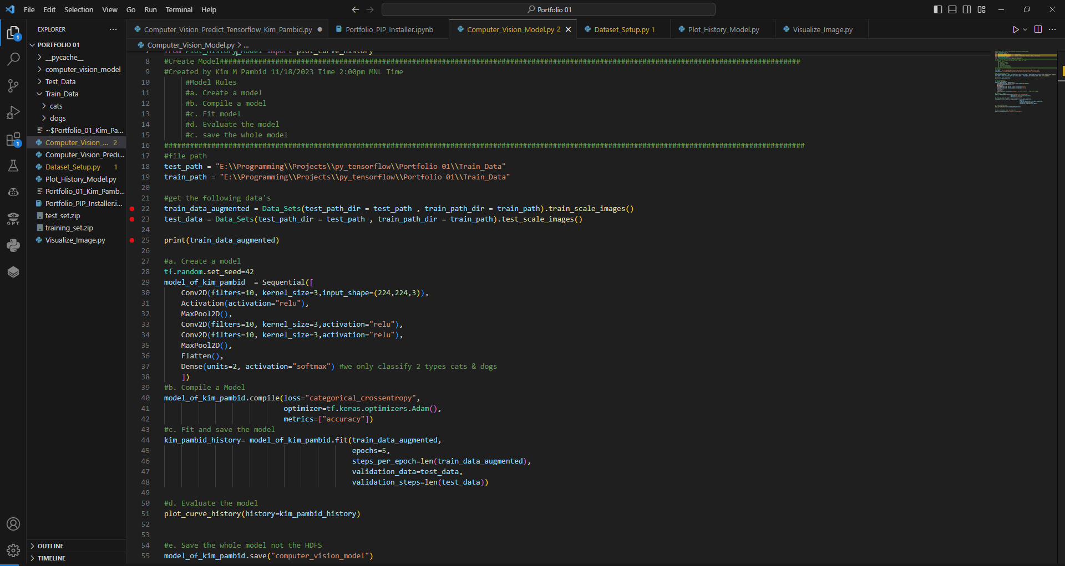
Model Creation
Just follow the box :D

Slide 8
These is hard to understand; but here it goes!
Brief explanation of what are these parts
Conv2D - This layer creates a convolution kernel that is convolved with
the layer input to produce a tensor of outputs .
Filters=10, #filter is the number of sliding windows going acreoss an
input(higher=more complex model)
Kernel_size=3, #the size of the sliding window going across an input
Strides=1, #the size of the step the sliding window takes across an input
Padding="valid", #if 'same' output shape is same with input,
if 'valid' output shape is compressed
Activation="relu", #applies much-needed non-linearity into the model or curves
input_shape=(224,224,3)), #input layer(specify input layer)
Relu - Rectified Linear Unit (Formula ReLU(x)=max(0,x)).
is an activation function that introduces the property of non-linearity to a
deep learning model and solves the vanishing gradients issue.
If you want to know about layers go to this URL: https://poloclub.github.io/cnn-explainer/
Reference: https://www.tensorflow.org/ and Udemy Zero to Mastery

Slide 9
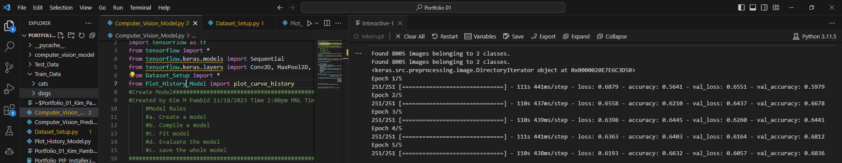
The Loss and Accuracy

Slide 10
Observe the loss and accuracy
and do alot of models!
It is time for model results plotting

Slide 11
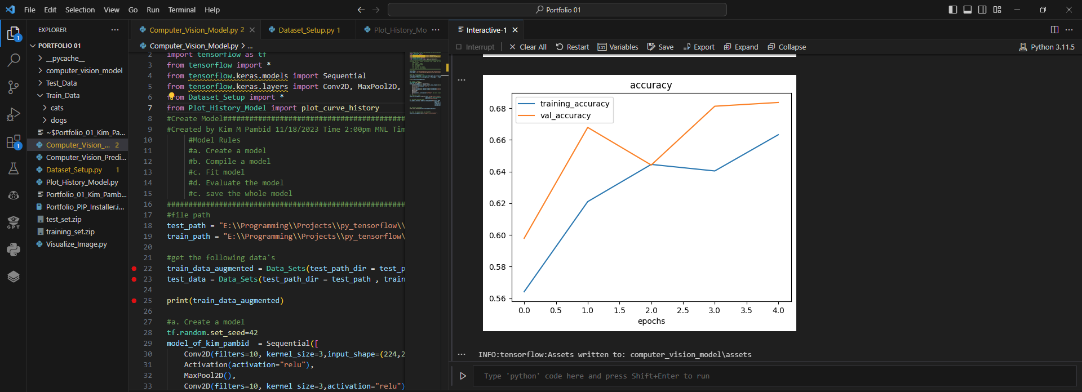
The Accuracy Plot
Too many trials to make it!!
Objectives: The training line should be near as possible with the validation lost line.

Slide 12
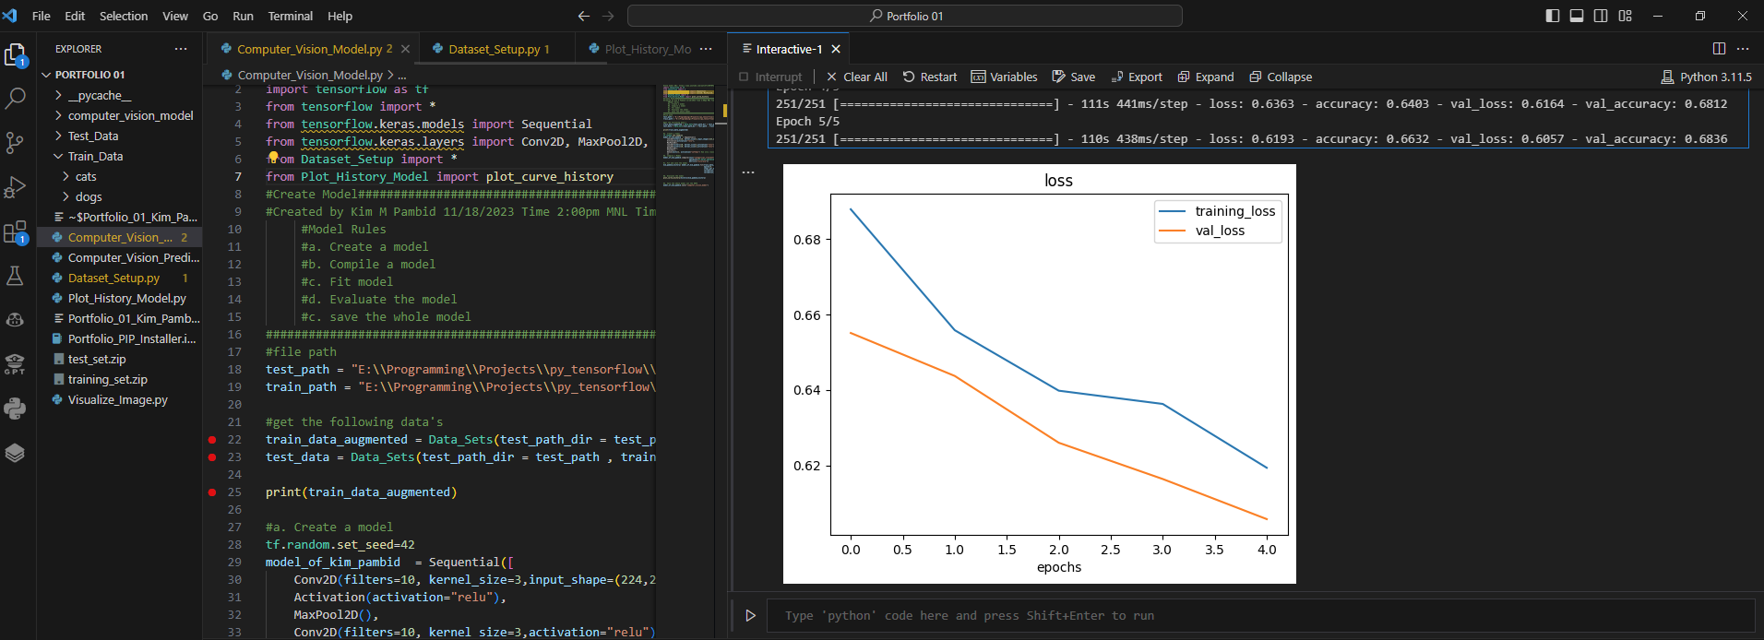
The Loss Plot
Objectives: The training line should be near as possible with the validation lost line.

Slide 13
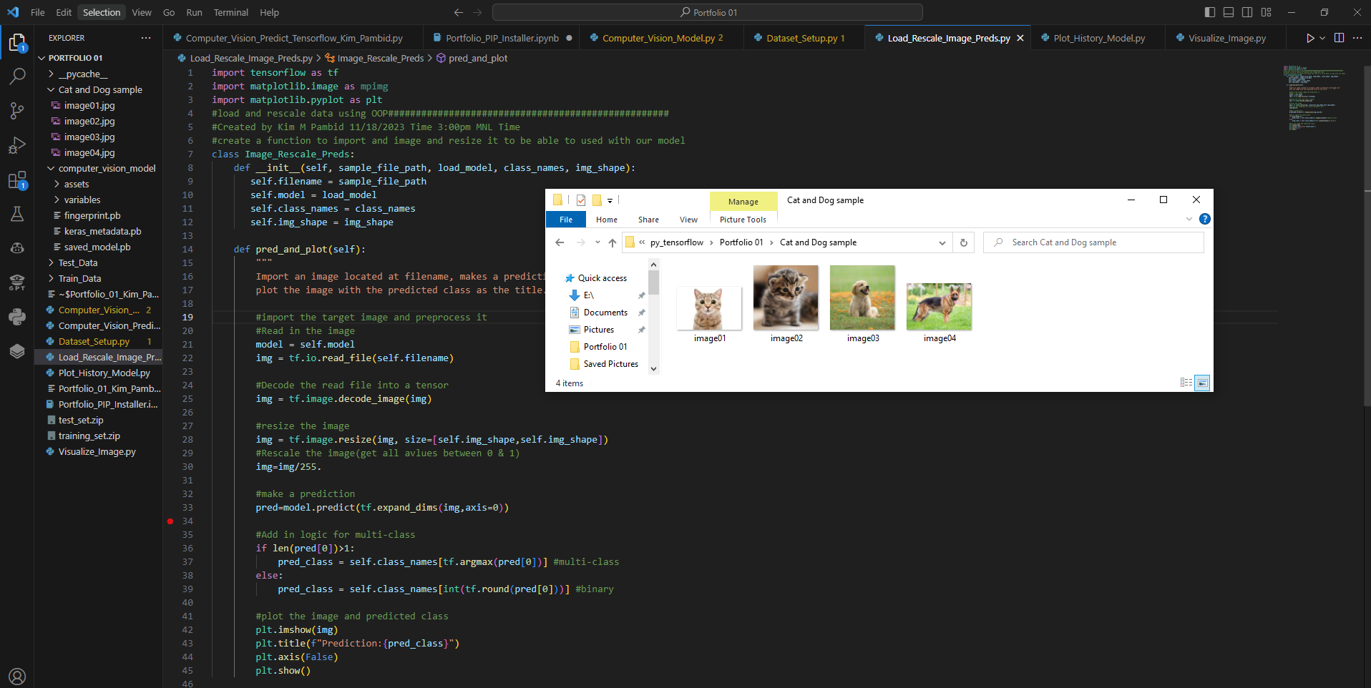
Rescale the images to 255x255 before prediction

Slide 14
That all folks!!!

Slide 15
Thanks for viewing :D
Check my github page for project info
(Next is video detection!!)

